Slide 1
Weekcode
Week 12: Weekcode Eulogy

Slide 2


THE END OF WEEKCODE
Weekcode has commenced
The last 11 presentations will be stapled onto this presentation for future reference
Skip to the end for unique Week 12 content
Remember: All content will live here forever: https://github.com/Sebo2003/Weekcode

Slide 3
Weekcode
Week 1: Introduction

Slide 4

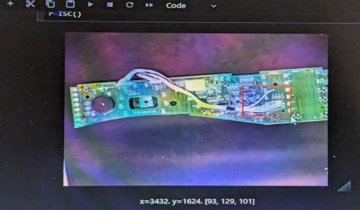
Who am I
Sebastian Przybylski
Been with the club for 5 semesters now
Obtained Associate’s from COD
Enrolled in Lewis
Intern at CoreCentricUSA as a Machine Vision intern

Slide 5

What is Leetcode
A website for interview prep
Hosts around 2900-3000 unique questions
Questions are divided as Easy/Medium/Hard
Excellent source for learning DSA

Slide 6
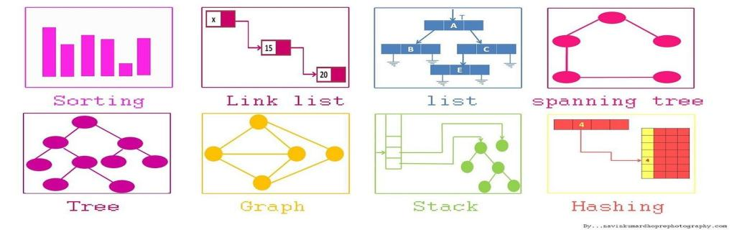
What is DSA
“Data Structures and Algorithms”
Data Structure: A specialized methodology of organizing, storing, and retrieving data
Algorithm: A list of tasks that are done to achieve an end state

Slide 7



Weekcode Introduction
A Leetcode problem you have a week to solve
3 (or more) DSA concepts will be introduced
A Leetcode problem will be introduced
Identify the correct DSA, then implement
Review answer following week, repeat!

Slide 8
Big O Notation
Big O Notation: A mathematical function that describes the asymptotic upper bound of an algorithm. Used to describe “Worse Case Scenarios”
Often referred to as Time Complexity
O=”order of”
n = input size
In computer science, Big O notation is used to classify algorithms according to how their running time or space requirements grow as the input size grows.

Slide 9
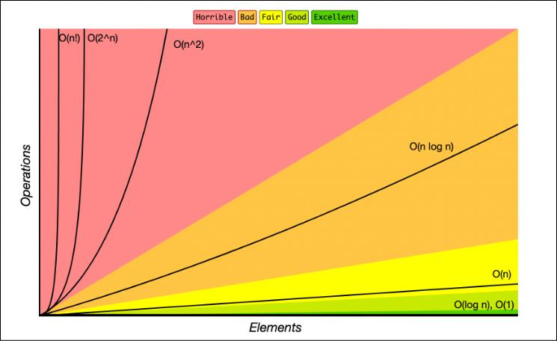

Slide 10
O(1)
Constant time
Input size is irrelevant to computational speed

Slide 11
O(n)
Running time is proportional to input size (n)
Linear

Slide 12
O(log n)
Running time grows in proportion to the log of the input size (n)
Logarithmic

Slide 13
O(n log n)
Combines aspects of O(log n) and O(n)
NOT the same as O(log n) + O(n) [two separate terms]
NOT the same as O(n + log n) [two separate terms]
“Linearithmic" or “Quasilinear”

Slide 14
O(n^2)
Running time is proportional to the square of the size input (n)
Quadratic

Slide 15
O(2^n)
Running time increases exponentially in proportion of the input size (n)
Exponential

Slide 16
O(n!)
Running time increases fractorially proportional to input size (n)
Fractal

Slide 17
Identifying Time Complexity
If there are multiple inputs, time complexity can be summed
Lower order terms and constants are usually summarized as some Big O function

Slide 18

Looking Ahead
Next week we will have our first Weekcode Challenge

Slide 19
Weekcode
Week 2: The TwoSub Problem

Slide 20

Weekcode Restructuralization
Instead of 3 DSA topics a week with 1 question, it will be 1 DSA topic with 3 questions
This week will be just 1 question

Slide 21
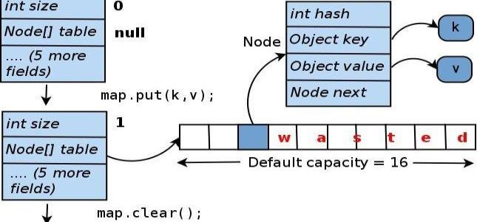
This week’s DSA concept:
HashMaps (or Dictionaries)

Slide 22
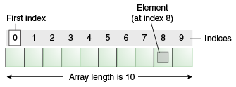
Quick Review of Arrays

Slide 23
Hashmap Fundamentals
Hashmaps allow for custom keys to find data
A datum in a Hashmap is called an Entry
All Entities are composed of a Key and a Value (<K,V>)
dict = { 01: Val1, 02: Val2, 03: Val3 }
KEY
VAL

Slide 24
Hashing Algorithms
An algorithm used to calculate the address of a key
DATA
MEMORY ADDRESS
MATH

Slide 25
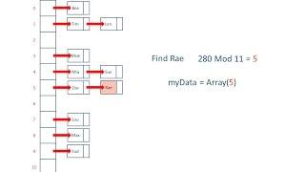
Good Example

Slide 26
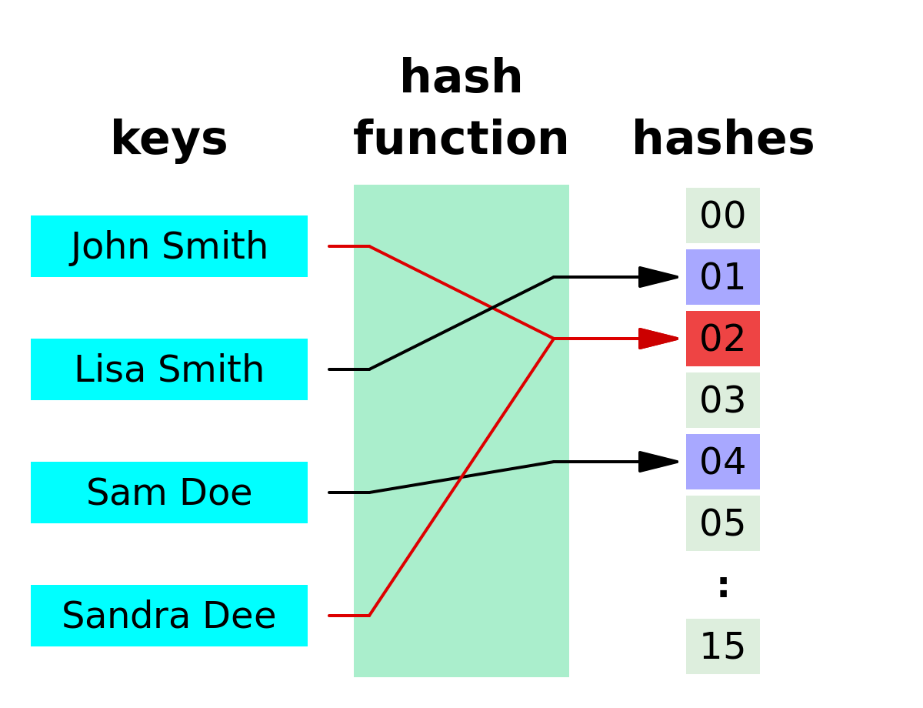
Collisions
What if a hash resolves data to an occupied memory address?

Slide 27
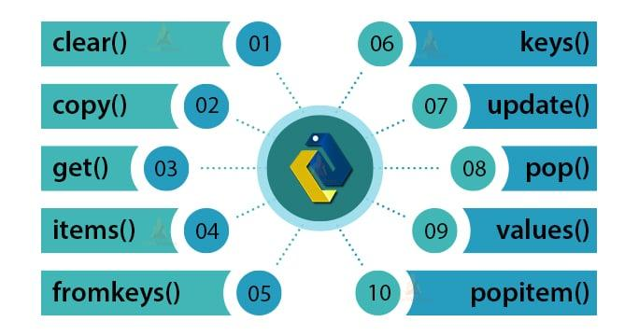
Dictionary Methods Explanation

Slide 28
Weekcode Challenge #1:
The TwoSub Problem
Given an array of integers, nums, and an integer, target, return indices of the two numbers such that they equal the difference of a target. You may assume that each input would have exactly one solution, and you may not use the same element twice. You can NOT return the answer in any order.
Input: nums = [5,8,0,3,2], target = -3
Output: [0,1] (But [1,0] is invalid)
Explanation: nums[0] - nums[1] = target;
5 - 8 = -3

Slide 29
Looking Ahead
Good Luck! More Challenges next week (MergeSort)

Slide 30
Weekcode
Week 3: The Merged & Split Lists Problems

Slide 31
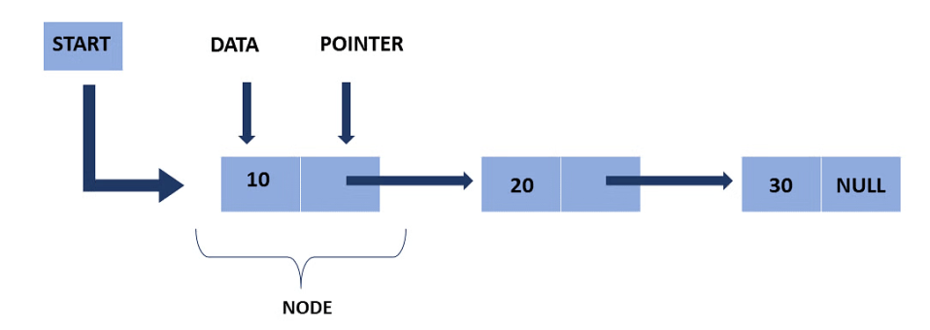
This week’s DSA concept:
Linked Lists

Slide 32
Quick Review of Computer Memory
RAM (Random Access Memory): A volatile memory bank used to store & quickly access session data
Stack Memory: A method of storing data via a stack (LIFO) on a thread, local variables are created from here (scope resolution), pointers not needed. Stack lives in the RAM
Heap Memory: Memory allocated to a program, which makes it “dynamic”. It is limited only by the OS, and may be accessed/deleted at any time. Heap lives in RAM

Slide 33
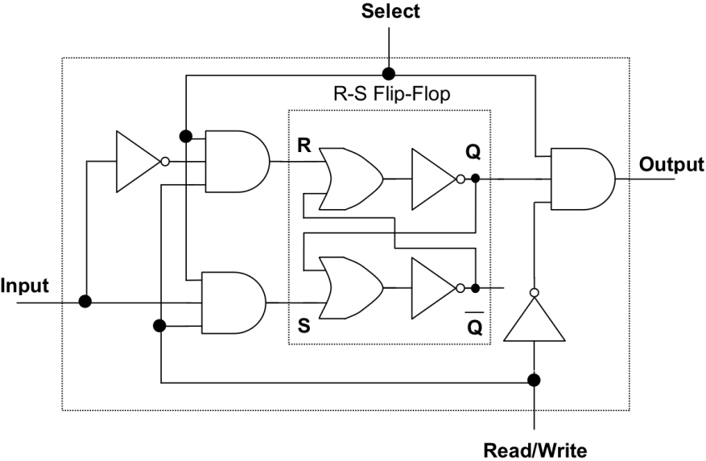
RAM

Slide 34
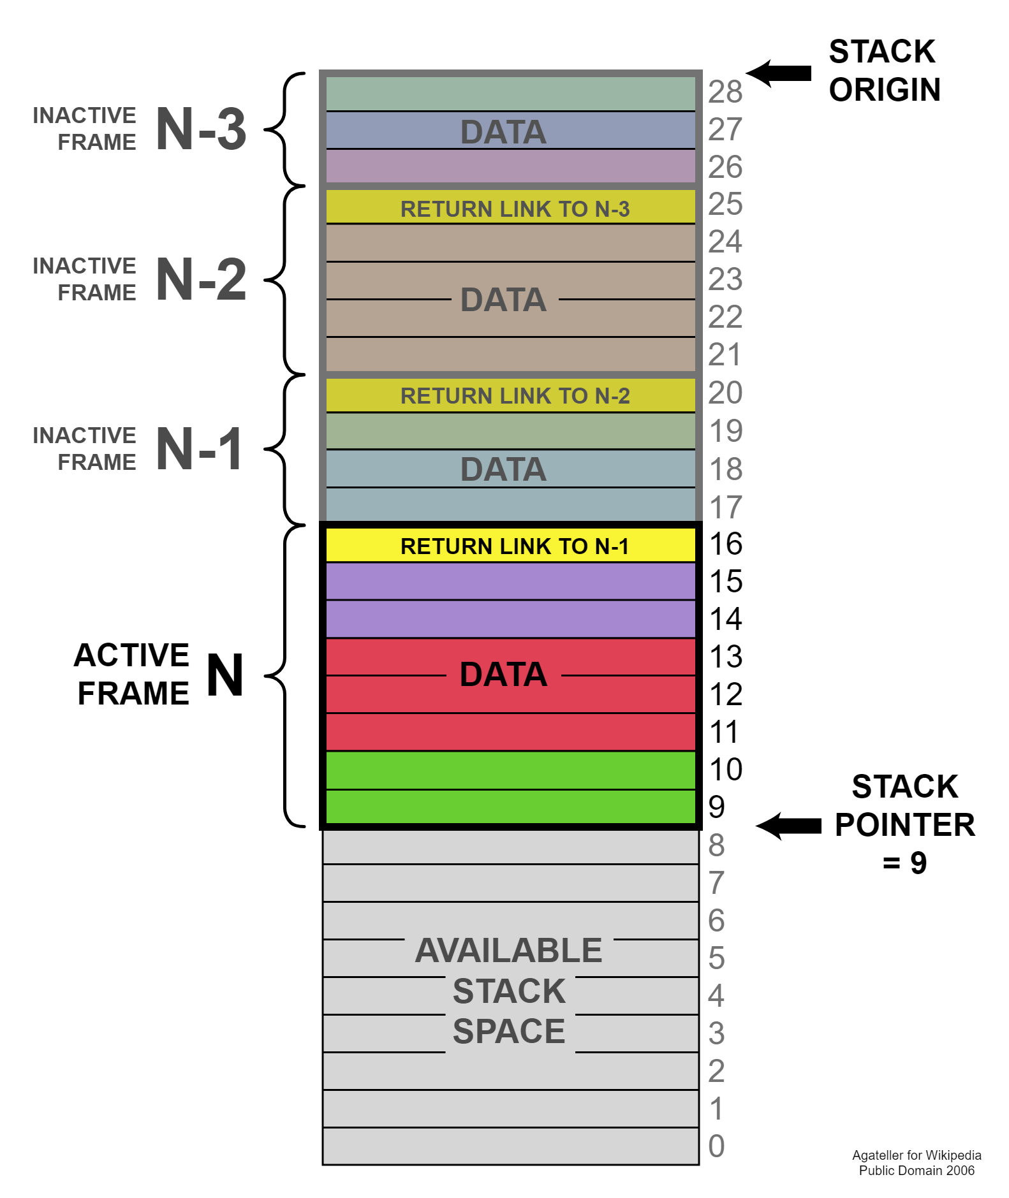
Stack

Slide 35
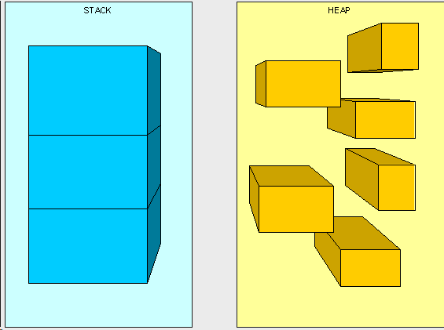
Heap

Slide 36
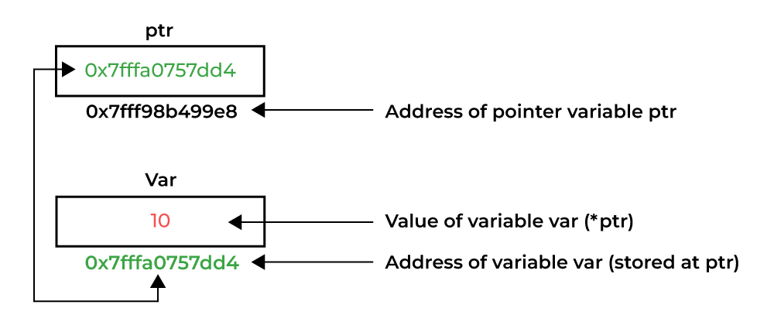
Introduction to Pointers & References
Pointers are objects that store memory addresses

Slide 37
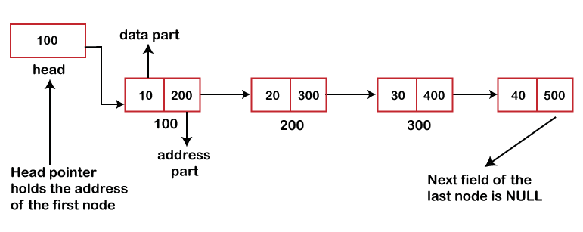
Introducing the Linked List
Linked Lists consists of nodes
Each node has two variables: value, and pointer

Slide 38
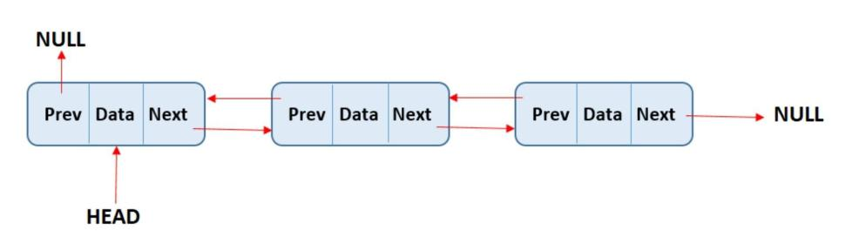
Doubly Linked List
Each Node also has a prev pointer

Slide 39
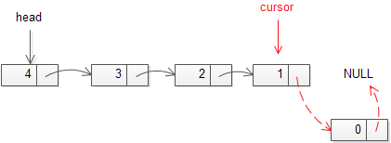
Traversing in Linked Lists
Cursor Pointer: Pointer that points to the value of the current node
Starting at the head, use a cursor pointer to print the value of the current node. Then, make the cursor point to the next node. Do this until the cursor points at nothing

Slide 40
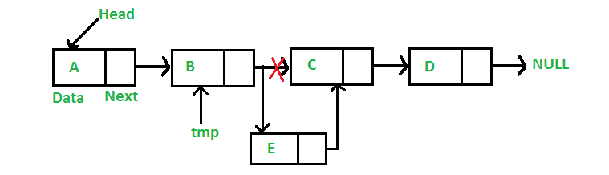
Insertion in Linked Lists
When inserting a node, make it so the node behind it now points to it, and the node itself points to the node ahead of it

Slide 41
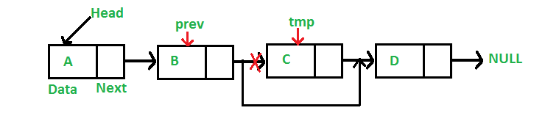
Deletion in Linked Lists
When deleting a node, make it so the node before it no longer points to it, but now points to the node ahead of the node you’re deleting. Ideally, then free that node into the heap

Slide 42
Weekcode Challenge #2:
The Merged Lists Problem
You are given the heads of two sorted linked lists list1 and list2.Merge the two lists into one sorted list. The list should be made by splicing together the nodes of the first two lists. Return the head of the merged linked list.
List1 and List2 are already sorted in increasing order!
Input: list1 = [1,2,4], list2 = [1,3,4]
Output: [1,1,2,3,4,4]
Input: list1 = [0,5,7,9,12], list2 = [4,8,13]
Output: [0,4,5,7,8,9,12,13]

Slide 43
Weekcode Challenge #3:
The Split Lists Problem
Given the head of a singly linked list and an integer k, split the linked list into k consecutive linked list parts.The length of each part should be as equal as possible: no two parts should have a size differing by more than one. This may lead to some parts being null. The parts should be in the order of occurrence in the input list, and parts occurring earlier should always have a size greater than or equal to parts occurring later. Return an array of the k parts. CONSTRAINT: MUST BE SINGLY-LINKED LIST
*hint: what is difference between division and modulo operations?
Input: head = [1,2,3], k = 5
Output: [[1],[2],[3],[],[]]
Input: head = [1,2,3,4,5,6,7,8,9,10], k = 3
Output: [[1,2,3,4],[5,6,7],[8,9,10]]

Slide 44
Looking Ahead
Good Luck! More Challenges next week!
Make sure you get boilerplate/example code from the GitHub!

Slide 45
Weekcode
Week 4: The Perfect Square, Minimum Divisor, and Median Problems

Slide 46
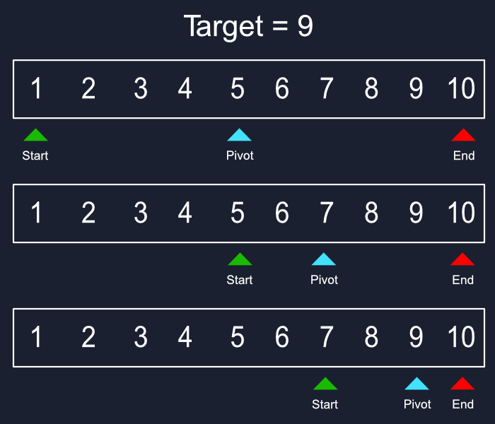
This week’s DSA concept:
Binary Search

Slide 47
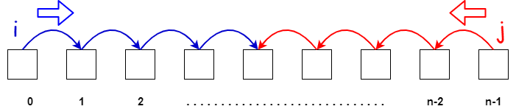
The “Two Pointer” Technique
Some Algorithms are referred to as “two pointer algorithms”
These are like markers that are in charge of monitoring the current state of the algorithm

Slide 48
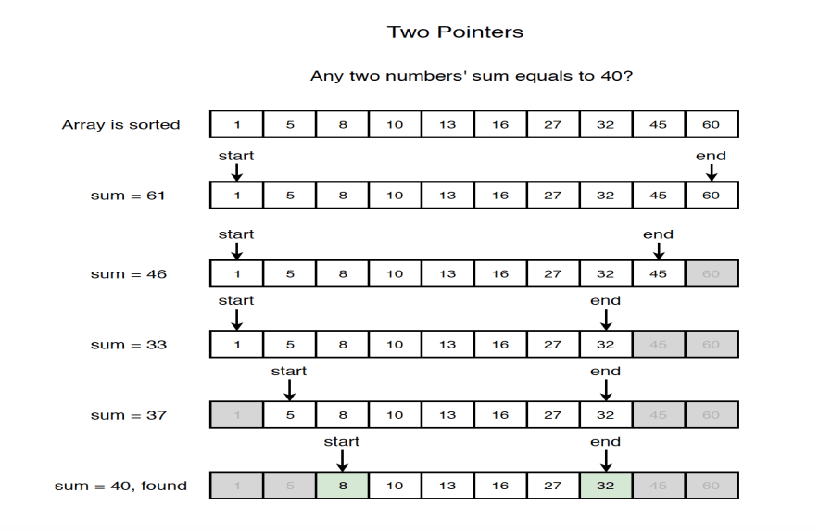

Slide 49
Introduction to Binary Search
A two-pointer algorithm
A searching algorithm
Extremely efficient with large data sets
ONLY WORKS ON PRE-SORTED DATA!

Slide 50
Why is Binary Search O(log n)?
n = size of input
k = current number of iterations
For every iteration, the size of the array is halved. In other words, n/2
n/2 becomes n/2/2, becomes n/2/2/2, and so on
In other words, n/2^1, n/2^2, n/2^3, n/2^4, and so on
Because this correlates to iteration k, we can say:
current size of array = n/2^k
When we reach a size of 1 element, then 1 = n/2^k
When solved algebraically, we find k = log(n)

Slide 51
Weekcode Challenge #4:
The Perfect Square Problem
Given a positive integer num, return True if num is a perfect square or False otherwise. A perfect square is an integer that is the square of an integer. In other words, it is the product of some integer with itself. You must not use any built-in library function, such as sqrt.
Input: num = 16
Output: True
Explanation: We return true because 4 * 4 = 16 and 4 is an integer.
Input: num = 14
Output: False
Explanation: We return false because 3.742 * 3.742 = 14 and 3.742 is not an integer.

Slide 52
Weekcode Challenge #5:
The Minimum Divisor Problem
Given an array of integers nums and an integer threshold, we will choose a positive integer divisor, divide all the array by it, and sum the division's result. Find the smallest divisor such that the result mentioned above is less than or equal to threshold. Each result of the division is rounded to the nearest integer greater than or equal to that element. (For example: 7/3 = 3 and 10/2 = 5).
In other words, ALWAYS ROUND UP! For example, we know that 2/5 = 0.4. Normally in integer division, we’d round down to 0. But in this case, round UP to 1. So for this problem, 2/5 = 1.

Slide 53
Weekcode Challenge #5:
The Minimum Divisor Problem
[EXAMPLES]
Input: nums = [1,2,5,9], threshold = 6
Output: 5
Explanation: (1/1 + 2/1 + 5/1 + 9/1) = 17, 17>6, so divisor is not 1. (1/2 + 2/2 + 5/2 + 9/2) = (1 + 1 + 3 + 5) = 10, 10>6, so divisor is not 2…. (1/5 + 2/5 + 5/5 + 9/5) = (1 + 1 + 1 + 2) = 5, 5<6 (A.K.A: the sum < threshold), so the divisor is 5
Input: nums = [44,22,33,11,1], threshold = 5
Output: 44

Slide 54
Weekcode Challenge #6:
The Median Problem
Given two sorted arrays nums1 and nums2 of size m and n respectively, return the median of the two sorted arrays as a float. The overall run time complexity should be O(log(m+n)).
Input: nums1 = [1,3], nums2 = [2]
Output: 2.00000
Explanation: merged array = [1,2,3] and median is 2.
Input: nums1 = [1,2], nums2 = [3,4]
Output: 2.50000
Explanation: merged array = [1,2,3,4] and median is (2 + 3) / 2 = 2.5.

Slide 55
Looking Ahead
Good Luck! More Challenges next week!
Make sure you get boilerplate/example code from the GitHub!

Slide 56
Weekcode
Week 5: The 5 Error Problem, The Implementation Problem, and the Reverse Pair Problem

Slide 57
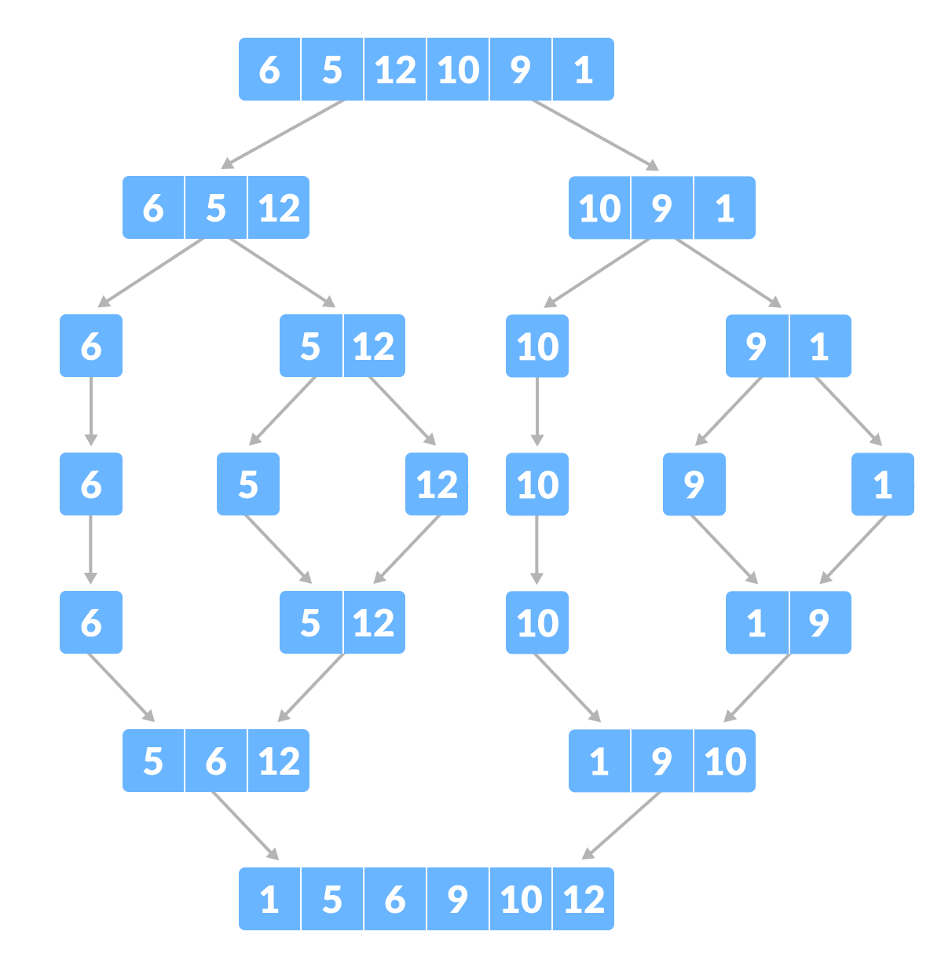
This week’s DSA concept:
Mergesort

Slide 58
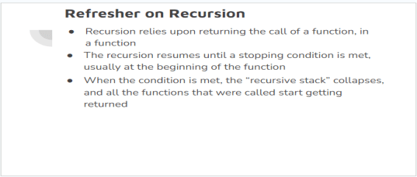

Refresher on Recursion
Recursion relies upon returning the call of a function, in a function
The recursion resumes until a stopping condition is met, usually at the beginning of the function
When the condition is met, the “recursive stack” collapses, and all the functions that were called start getting returned

Slide 59
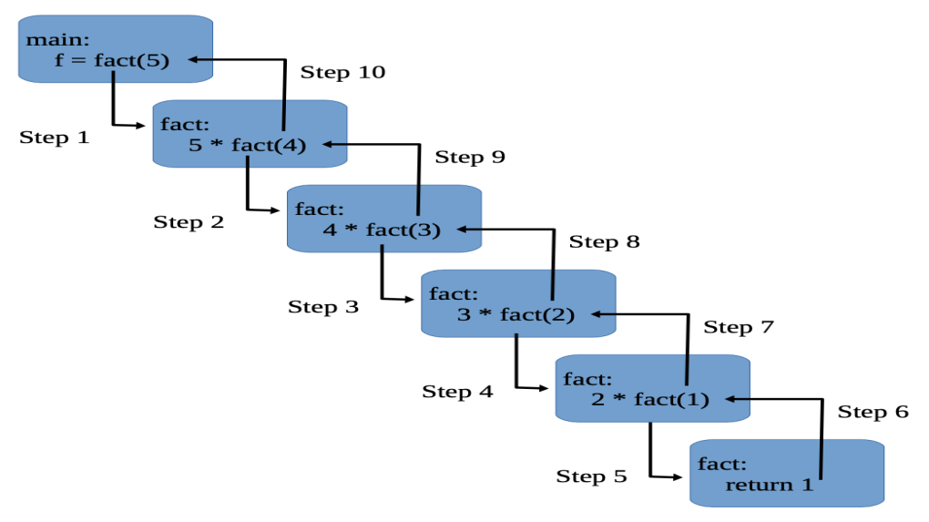

Slide 60
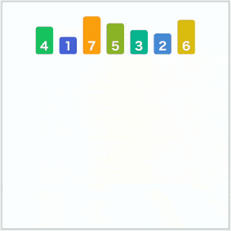
Introduction to Mergesort
Sorting Algorithm
“Divide and Conquer” Algorithm
Great for sorting large data sets
Almost always implemented via recursion
O(n log n)

Slide 61
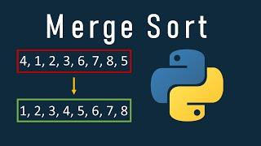
Mergesort steps in a nutshell
1) Slice: Cut all elements in the list into individual arrays
2) Sort: Organize the elements by value
3) Merge: Put it all together again
4) Repeat: Repeat until break case is reached (in recursion)

Slide 62
Weekcode Challenge #7:
The 5 Errors Problem
You are given a .py file that tries to attempt Mergesort. However, 5 logical errors exist that prevent the code from compiling. You must identify the 5 logical errors and fix them. Further clarification exists in the code.
This problem can only be attempted by pulling the “easyBOILERPLATE.py” file from the week5 folder on the Weekcode GitHub (which is easily accessible from our Discord server)

Slide 63
Weekcode Challenge #8:
The Implementation Problem
Given an array of integers nums, sort the array in ascending order and return it. You must solve the problem without using any built-in functions in O(nlog(n)) time complexity and with the smallest space complexity possible.
Input: nums = [5,2,3,1]
Output: [1,2,3,5]
Explanation: After sorting the array, the positions of some numbers are not changed (for example, 2 and 3), while the positions of other numbers are changed (for example, 1 and 5).

Slide 64
Weekcode Challenge #9:
The Reverse Pairs Problem
Given an integer array nums, return the number of reverse pairs in the array.
A reverse pair is a pair (i, j) where:
0 <= i < j < nums.length
nums[i] > 2 * nums[j]
Input: nums = [1,3,2,3,1]
Output: 2
Explanation: The reverse pairs are:
(1, 4) --> nums[1] = 3, nums[4] = 1, 3 > 2 * 1
(3, 4) --> nums[3] = 3, nums[4] = 1, 3 > 2 * 1
Input: nums = [2,4,3,5,1]
Output: 3
Explanation: The reverse pairs are:
(1, 4) --> nums[1] = 4, nums[4] = 1, 4 > 2 * 1
(2, 4) --> nums[2] = 3, nums[4] = 1, 3 > 2 * 1
(3, 4) --> nums[3] = 5, nums[4] = 1, 5 > 2 * 1

Slide 65
Looking Ahead
Good Luck! More Challenges next week!
Make sure you get boilerplate/example code from the GitHub!

Slide 66
Weekcode
Week 6: The Baseball Problem and The Ticket Problem

Slide 67
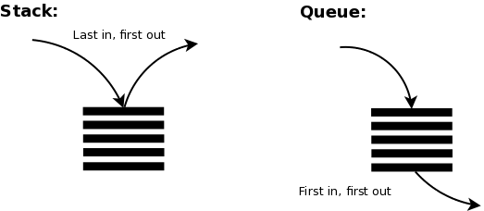
This week’s DSA concepts:
Stacks & Queues

Slide 68
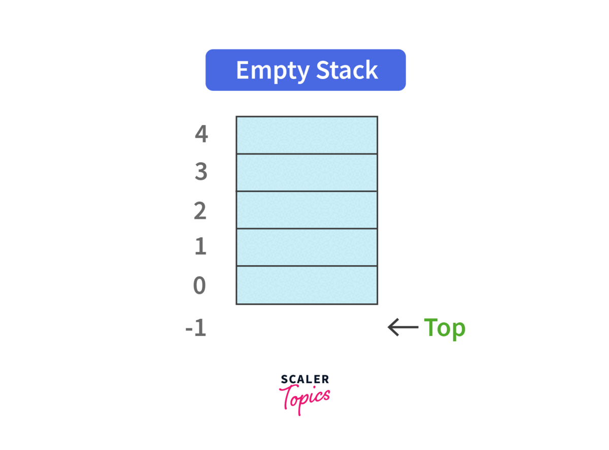
Stacks Explained
Last In First Out (LIFO)
Like stacking lunch trays
Relies upon .push() and .pop()

Slide 69
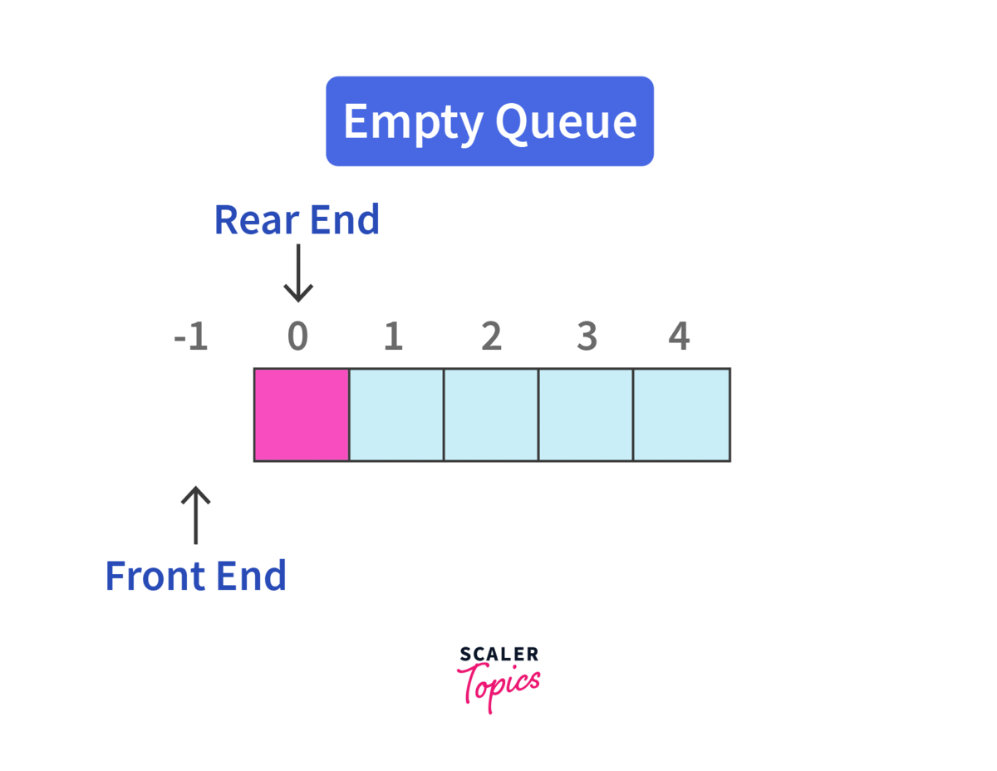
Queues Explained:
First In First Out (FIFO)
Like standing in line
Relies upon .enqueue() and .dequeue()

Slide 70
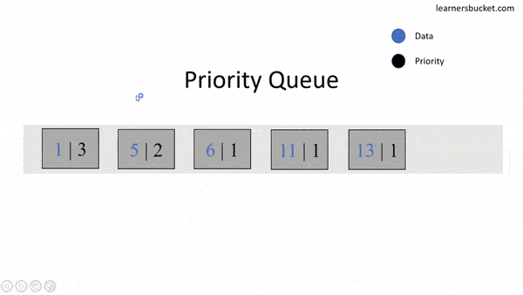
Priority Queues
Special Queue variant where values are weighted
Can be thought of as priority mailing

Slide 71
Weekcode Challenge #10:
The Baseball Problem
You are keeping the scores for a baseball game with strange rules. At the beginning of the game, you start with an empty record. You are given a list of strings operations, where operations[i] is the i^{th} operation you must apply to the record and is one of the following:
An integer x :
Record a new score of x.
'+':
Record a new score that is the sum of the previous two scores.
'D':
Record a new score that is the double of the previous score.
'C':
Invalidate the previous score, removing it from the record

Slide 72
Weekcode Challenge #10:
The Baseball Problem
[EXPLAINED]
Input: ops = ["5","2","C","D","+"]
Output: 30
Explanation:
"5" - Add 5 to the record, record is now [5].
"2" - Add 2 to the record, record is now [5, 2].
"C" - Invalidate and remove the previous score, record is now [5].
"D" - Add 2 * 5 = 10 to the record, record is now [5, 10].
"+" - Add 5 + 10 = 15 to the record, record is now [5, 10, 15].
The total sum is 5 + 10 + 15 = 30.

Slide 73
Weekcode Challenge #10:
The Baseball Problem
[EXPLAINED FURTHER]
Input: ops = ["5","-2","4","C","D","9","+","+"]
Output: 27
Explanation:
"5" - Add 5 to the record, record is now [5].
"-2" - Add -2 to the record, record is now [5, -2].
"4" - Add 4 to the record, record is now [5, -2, 4].
"C" - Invalidate and remove the previous score, record is now [5, -2].
"D" - Add 2 * -2 = -4 to the record, record is now [5, -2, -4].
"9" - Add 9 to the record, record is now [5, -2, -4, 9].
"+" - Add -4 + 9 = 5 to the record, record is now [5, -2, -4, 9, 5].
"+" - Add 9 + 5 = 14 to the record, record is now [5, -2, -4, 9, 5, 14].
The total sum is 5 + -2 + -4 + 9 + 5 + 14 = 27.

Slide 74
Weekcode Challenge #11:
The Ticket Problem
There are n people in a line queuing to buy tickets, where the 0th person is at the front of the line and the (n - 1)^{th} person is at the back of the line.
You are given a 0-indexed integer array tickets of length n where the number of tickets that the i^{th} person would like to buy is tickets[i].
Each person takes exactly 1 second to buy a ticket. A person can only buy 1 ticket at a time and has to go back to the end of the line (which happens instantaneously) in order to buy more tickets. If a person does not have any tickets left to buy, the person will leave the line.
Return the time taken for the person at position k (0-indexed) to finish buying tickets.

Slide 75
Weekcode Challenge #11:
The Ticket Problem
[EXPLAINED]
Input: tickets = [2,3,2], k = 2 Output: 6
Explanation:
- In the first pass, everyone in the line buys a ticket and the line becomes [1, 2, 1].
- In the second pass, everyone in the line buys a ticket and the line becomes [0, 1, 0].
The person at position 2 has successfully bought 2 tickets and it took 3 + 3 = 6 seconds.

Slide 76
Weekcode Challenge #11:
The Ticket Problem
[EXPLAINED FURTHER]
Input: tickets = [5,1,1,1], k = 0 Output: 8
Explanation:
- In the first pass, everyone in the line buys a ticket and the line becomes [4, 0, 0, 0].
- In the next 4 passes, only the person in position 0 is buying tickets.
The person at position 0 has successfully bought 5 tickets and it took 4 + 1 + 1 + 1 + 1 = 8 seconds.

Slide 77
Looking Ahead
Good Luck! More Challenges next week!
Make sure you get boilerplate/example code from the GitHub!

Slide 78
Weekcode
Week 7: The Substring Problem, The Twin Duplicates Problem, & The Binary Sum Problem

Slide 79
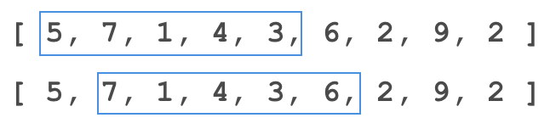
This week’s DSA concept:
Sliding Window

Slide 80
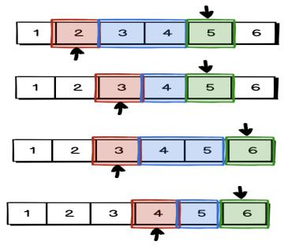
Sliding Window Technique
More of a technique than a pure Data Structure or Algorithm
Works in conjunction with other techniques, like 2 pointer

Slide 81
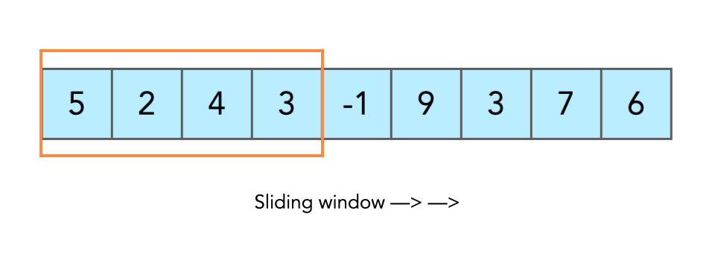
Sliding Window Explained
A “Sliding Window” is a range of consideration to solve some problem
The size of the window does not have to be static per iteration
Commonly used to supplement nested loop O(n^2) algorithms to make them O(n) or single-pass

Slide 82
Weekcode Challenge #12:
The Substring Problem
A string is good if there are no repeated characters. Given a string s​​​​​, return the number of good substrings of length three in s​​​​​​. Note that if there are multiple occurrences of the same substring, every occurrence should be counted. A substring is a contiguous sequence of characters in a string.
Input: s = "xyzzaz"
Output: 1
Explanation: There are 4 substrings of size 3: "xyz", "yzz", "zza", and "zaz".
The only good substring of length 3 is "xyz".

Slide 83
Weekcode Challenge #12:
The Substring Problem
[EXPLAINED FURTHER]
Input: s = "aababcabc"
Output: 4
Explanation: There are 7 substrings of size 3: "aab", "aba", "bab", "abc", "bca", "cab", and "abc".
The good substrings are "abc", "bca", "cab", and "abc".

Slide 84
Weekcode Challenge #13:
The Twin Duplicates Problem
Given an integer array nums and an integer k, return true if there are two distinct indices i and j in the array such that
nums[i] == nums[j] and abs(i - j) <= k.
Input: nums = [1,0,1,1]
k = 1
Output: true
Input: nums = [1,2,3,1]
k = 3
Output: true
Input: nums = [1,2,3,1,2,3]
k = 2
Output: false

Slide 85
Weekcode Challenge #14:
The Binary Sum Problem
Given a binary array nums and an integer goal, return the number of non-empty subarrays with a sum goal. A subarray is a contiguous part of the array.
Input: nums = [1,0,1,0,1], goal = 2
Output: 4
Explanation: The 4 subarrays are bolded and underlined below:
[1,0,1,0,1]
[1,0,1,0,1]
[1,0,1,0,1]
[1,0,1,0,1]
= 1 + 0 + 1 = 2 = goal
= 1 + 0 + 1 + 0 = 2 = goal
= 0 + 1 + 0 + 1 = 2 = goal
= 1 + 0 + 1 = 2 = goal

Slide 86
Weekcode Challenge #14:
The Binary Sum Problem
[EXPLAINED FURTHER]
[0,0,0,0,0]
[0,0,0,0,0]
[0,0,0,0,0]
[0,0,0,0,0]
[0,0,0,0,0]
[0,0,0,0,0]
[0,0,0,0,0]
[0,0,0,0,0]
[0,0,0,0,0]
[0,0,0,0,0]
[0,0,0,0,0]
[0,0,0,0,0]
[0,0,0,0,0]
[0,0,0,0,0]
[0,0,0,0,0]
Input: nums = [0,0,0,0,0]
goal = 0
Output: 15
Explanation: Subarrays can be just 1 element long, or as long as the entire list, as long as it sums to goal. There are
15 unique permutations to sum 0 from
[0,0,0,0,0], shown to the right:

Slide 87
Looking Ahead
Good Luck! Midterm break next week!
Hackathon is on March 16th this Saturday!
Make sure you get boilerplate/example code from the GitHub!

Slide 88
Weekcode
Tree Month
Week 8: The Tree Vocabulary Exercise, Tree Properties Exercise, and Tree Memory Exercise

Slide 89

April is Tree Month
Every Weekcode in April will be related to Trees
This week will cover Tree fundamentals
Following weeks will cover various Tree data structures

Slide 90
Real-World Tree Applications
Windows, Unix, and macOS use Trees to organize their hierarchical file systems
Compilers rely upon ASTs (Abstract Syntax Trees) to translate syntactically correct code
Compression of files uses entropy coding techniques to identify redundant data, which is built upon Huffman Trees (.jpeg, .zip, .mpeg, ect)
Decision Trees are used in machine learning to predict output based on input, which aids in the regression process

Slide 91
Real-World Tree Applications [More]
Spanning Trees are used in IT networking topologies to ensure efficient broadcasting of data packets and to prevent Bridge Loops
XML/HTML files are parsed as DOM (Document Object Model) Trees (Javascript frontend frameworks manipulate virtual DOMs)
B-Trees are often used in large relational databases for various queries
Game designers use Trees to swap objects in accordance to their LOD (Level of Detail) in a scene relative to rendering distance from camera

Slide 92
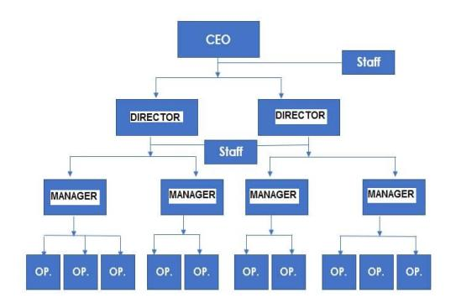

Introduction to Trees
Trees are a type of graph
Trees come in several varities
Primary components of a Tree:
Hierarchical
Non-Linear
Relationships

Slide 93
Relationships within a Tree
Node: Individual item on a Tree
Edge: Relational links between Nodes
Parent: A Node that derives other Nodes
Child: A Node derived from a Node
Sibling: Children derived of the same Parents
Leaf: A Child with no Children of its own
Ancestor: A Parent with “Grandchildren”
Descendant: A “Grandchild” of an Ancestor
Root: The Ancestor of all Nodes on the Tree
Subtree: A Tree within a Tree

Slide 94


Slide 95
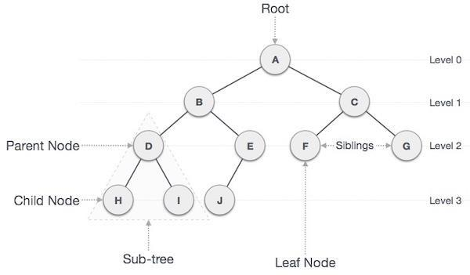

Slide 96
The Many Forms of Trees
Trees can take can be organized into various forms:
Binary Tree
Heap
Max Heap
Min Heap
Binary Search Tree
Splay Tree
AVL Tree
Red-Black Tree
Trie
B-Tree

Slide 97
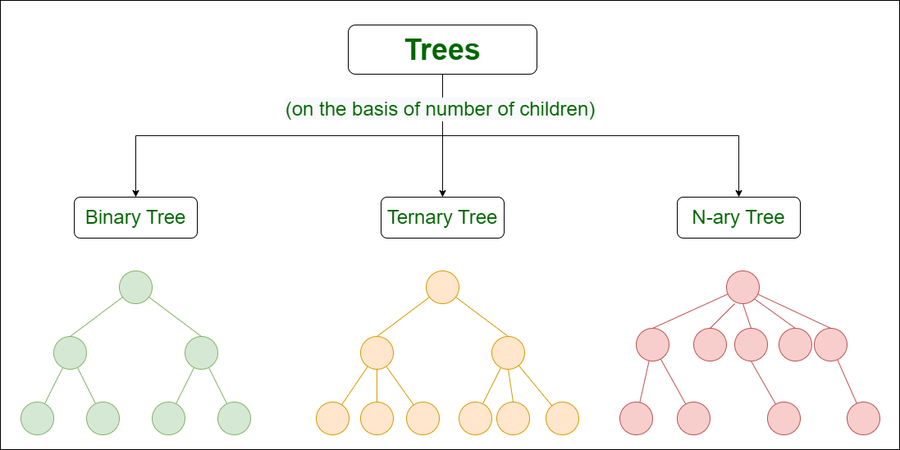

Slide 98
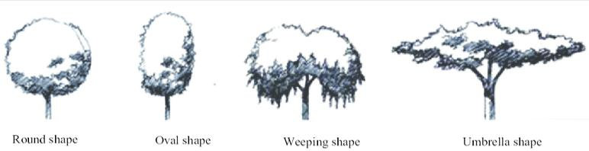
Introduction to Tree Validity
Shape: The organization of Nodes and Edges of a Tree
The Shape of a Tree can change from Tree type to Tree type, and each Tree type will have some unique rules for Shape validity
There are some rules of validity that are true for all Trees, however

Slide 99
Rules of Tree Validity:
1) All Trees have only 1 Root, and the Root never has Parents
2) All Children have exactly 1 Parent, and all Children have 0-X amount of their own Children
3) All Nodes have at least 1 Edge (The Root only has outgoing Edges, Leaves only have incoming Edges, and all other Nodes have only 1 incoming Edge and X outgoing Edges
4) All Nodes only connect to the layer immediately above or below them
5) All Trees are acyclical

Slide 100
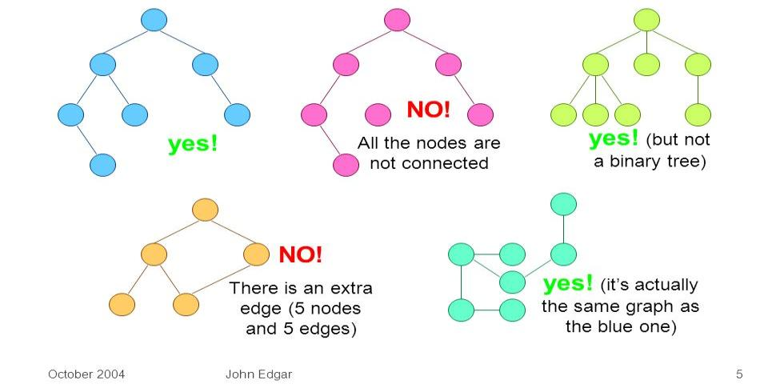
Are these Trees valid?

Slide 101
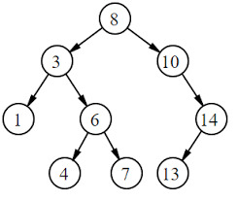
Edges of a Tree
In a valid Tree, every inner Node will have 1 incoming Edge, and X outgoing Edges
The Root will never have incoming Edges
For any valid Tree of N Nodes, there will be ____ Edges
N-1 Edges for any valid Tree of N Nodes

Slide 102
Depth, Height, and Level of Trees
All Trees have Depth, Height, and Levels
Depth: The distance from some Node N from its Root R
Height: The distance between some Node N and the furthest Leaf that exists in N’s subtree
Level: Refers to the generational distance a group of Nodes have to some other group of Nodes
The Depth of all Roots is 0, and the Height of all Leaves is 0
In a valid Tree, maximum Height will always equal maximum Depth

Slide 103
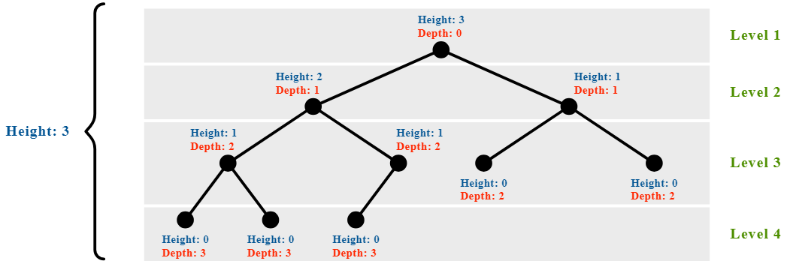
Leaves of the same Level will always have identical Depths and Heights to each other

Slide 104
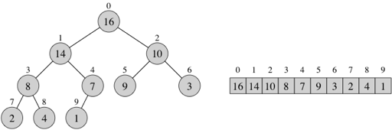
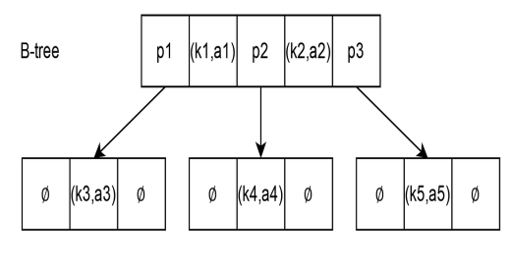
How are Trees stored in Memory?
Two primary methods of storing Nodes in memory:
Array-Based Indexing (Common for Binary Trees)
Pointer-Based Indexing (Common for B-Trees)

Slide 105
Array-Indexed Trees [Breadth-First]
Only works for Tree with fixed branching degrees (binary = 2, ternary = 3, quaternary = 4, ect)
Root is established at index 0
All Nodes are inserted from left to right respective to the Level of the Tree
The index of any Child in an array can be expressed as: Ai + B (A = degree of branching, i = index of Parent, B = offset from i)
ex): In a Binary Tree, a Parent’s Child can be found 2i + 0 or 2i + 1 indexes from its Parent (0 = left Child, 1 = right Child.

Slide 106
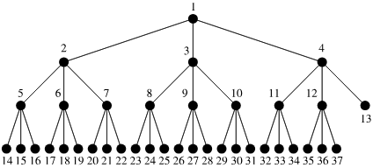
If this Tree were stored in an array, index 0 would be 1, and index 36 (the last index) would be 37 (Hence, “Breadth-First”)

Slide 107
Pointer-Indexed Trees [Depth-First]
Similar to a Doubly Linked List (and thus stored in memory in basically the same way)
Each Node must have at least three fields:
Left Pointer
Data
Right Pointer
Three major methods of Pointer-Tree Traversal (all are recursive):
Preorder Traversal: Begin at the Root, iterate through the left subtree, and then the right subtree
Inorder Traversal: Begin in the left subtree, iterate until you reach the Root, then iterate over the right subtree
Postorder Traversal: Begin in the left subtree, then the right subtree, and finish at the Root

Slide 108
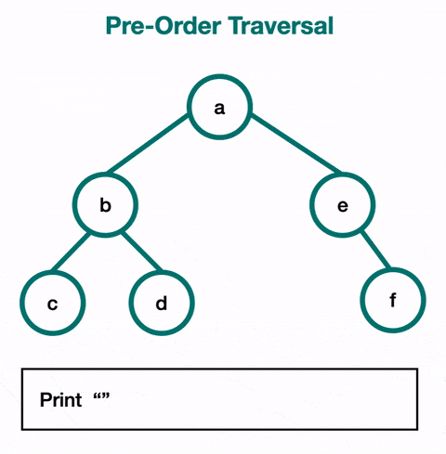
<root><left><right>

Slide 109

<left><root><right>

Slide 110
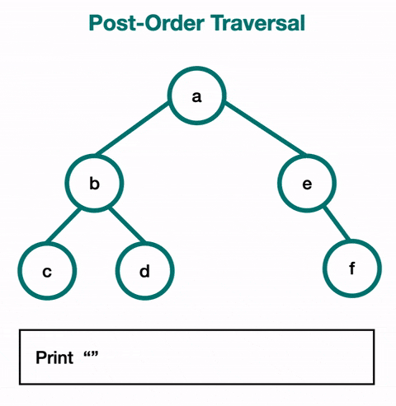
<left><right><root>

Slide 111

Weekcode Challenge #15:
Tree Vocabulary Exercise
Step 1) Draw a Tree with Valid Shape that has at least 11 Nodes
Step 2) Label the Tree using every vocabulary word used on the “Relationships within a Tree” slide

Slide 112

Weekcode Challenge #16:
Tree Properties Exercise
Using your Tree from the previous problem, label the Depth and Height of every Node, then label all Levels of your Tree

Slide 113

Weekcode Challenge #17:
Tree Memory Exercise
Step 1) Populate each Node with random data (doesn’t matter if it technically violates some rules of your Tree type, just give each Node some value, and keep data type consistent for the whole Tree).
Step 2) Organize your Nodes in an indexed array.
Step 3) Organize your Nodes in Pre, In, and Postorder Traversal order

Slide 114
Looking Ahead
Good luck!
Tree Month will persist for all of April
Next week: More Tree stuff

Slide 115
Weekcode
Tree Month
Week 9: The BFS Queue Problem & The DFS Stack Problem

Slide 116
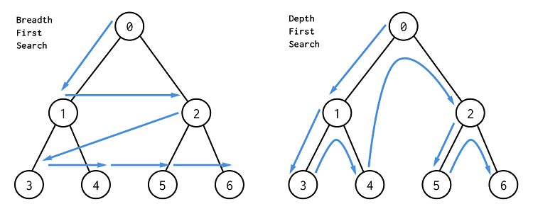
This week’s Tree Concept:
BFS and DFS

Slide 117
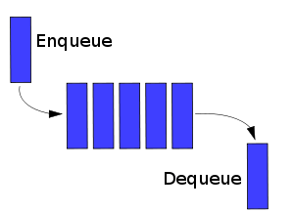
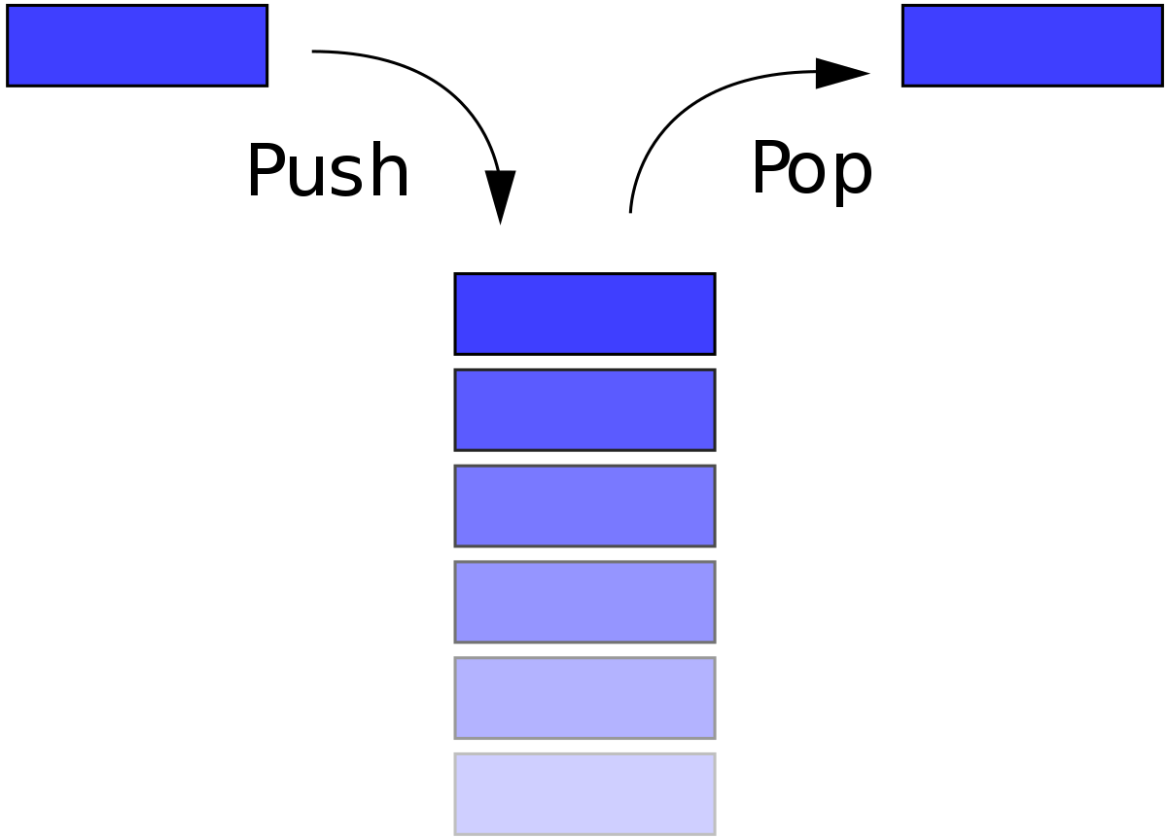
Review of Stacks and Queues
Stack: Last In First Out (LIFO) methodology
Queue: First In First Out (FIFO) methodology
REAR
FRONT
TOP
BOTTOM

Slide 118
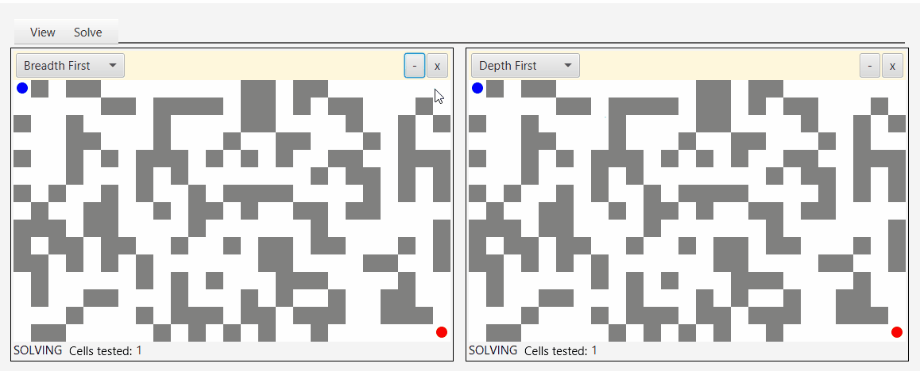
Introduction to BFS and DFS
BFS = Breadth-First Search (Left to Right)[Simplified]
DFS = Depth-First Search (Up and Down)[Simplified]
Both are traversal algorithms to iterate over Nodes in a graph (in our case, Trees)
Either is typically implemented when we want to find a specific Node in a graph or visit all Nodes (traversal)

Slide 119
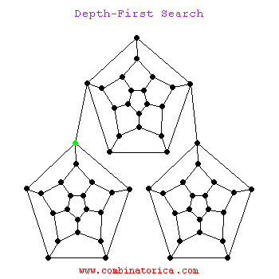




BFS
DFS

Slide 120
BFS and Queues
In BFS, all Nodes of a Level are visited before any Node of the descending Level (recall from the previous presentation)
Logically then, it makes sense to store Nodes in Queueing order, because:
Queues will store index integrity while traversing Nodes per Level (by breadth, in other words)

Slide 121


Slide 122
BFS Implementation:
BFS is only concerned with per-Level indexing
Thus, when we reach the rightmost Node of any Level, we must deque our entire queue to keep the traversal order accurate (this becomes our “visited” list)
Therefore, by the FIFO nature of Queues, we remove the leftmost Node of the current Level up until we remove our rightmost Node
Then, we begin again at the new Level, adding the leftmost Node first. Once we reach the rightmost Node, our leftmost Node will be at the very front of the Queue, and as such, will be dequeued first (remember: FIFO)

Slide 123


Slide 124
DFS and Stacks
In DFS, we travel down the leftmost Nodes from some starting Node, per subtree
Once we reach the left leaf of some subtree, we travel back up to our root, go down the right subtree (if there is one), sticking to the left side of that subtree if there is a left side
We continue this until the rightmost Node of the rightmost subtree is visited (in other words, the rightmost leaf of lowest Level)

Slide 125


Slide 126
DFS Implementation:
DFS is only concerned with reaching Leaves as quickly as possible
Therefore, DFS is commonly implemented using Pre, In, or Post Order Traversal. Of the 3, Inorder Traversal is most common
Using a stack for any of these traversal orders is appropriate. This is because of the LIFO nature of stacks meshes with the DFS method of traveling as far down a branch as you can go, and then backtracking (pushing and then popping)

Slide 127


Slide 128

Weekcode Challenge #18:
The BFS Queue Problem
You are given a Tree with populated Nodes. Your job is to print the entire contents of the Tree using BFS and Queues. Only implementation of BFS using Queues is valid

Slide 129
Weekcode Challenge #19:
The DFS Stack Problem
You are given a Tree with populated Nodes. Your job is to print the entire contents of the Tree using DFS and Stacks. Only implementation of DFS using Stacks is valid

Slide 130
Looking Ahead
Good luck!
Tree Month will persist for all of April
Next week: Min and Max Heaps

Slide 131
Weekcode
Tree Month
Week 10: The BST Searching Problem, BST Insertion Problem, and the BST Deletion Problem

Slide 132

This week’s Tree Concept:
Binary Search Trees

Slide 133
Binary Tree Rules of Shape Validity:
All Parents have AT MOST 2 Children (Left and Right)
The Left Child of a Parent always has a smaller value than the Parent, and the Right Child of a Parent will always have a larger value than the Parent
Thus, all Nodes of a Root’s Right Subtree will have values greater than itself, and all Nodes of a Root’s Left Subtree will have values lesser than itself
Binary Search Trees are used for Searching, Insertion, and Deletion

Slide 134
Balanced vs. Unbalanced Binary Trees
The ideal Shape of any Binary Tree is “balanced”
A Binary Tree is balanced when:
The difference in Height between the Left and Right Subtrees differs by no more than 1
|H_{L} - H_{R}| ≤ 1

Slide 135


Slide 136

All Interior Nodes have 2 Children AND all Leaves are of the same Level
Height of Left and Right subtrees differ by no more than 1
All Nodes have either 2 or 0 Children
All Levels, except the last one, are completely filled
Each Parent has only 1 Child

Slide 137
How to determine Number of Nodes in a Binary Tree
Size (S) = Maximum possible number of Nodes in a Tree
Since, in a Binary Tree, all Parents have at most 2 Children, we can determine the maximum amount of Nodes at any given Level (L) to be: 2^{L-1} . By extension, we then know 2^{L} will be the maximum amount of Nodes in the whole Tree
However, the first Level of any Tree will always have just 1 Node (Root), Therefore:
*Note: This formula can also derive number of Nodes of any Subtree as well, as long as you know the Level of your Subtree’s Root (R):
S = 2^{(L-R)+1} - 1
*Note: By extension, since we know max Level = max Height, we can say the maximum possible Height of a Binary Tree is:
L or max H = log₂(S+1)
S = 2^{L} - 1

Slide 138

Construction of Binary Search Trees
BSTs are used to store data which can be searched, updated, appended, and deleted
Therefore, the structure of a BST is dynamic; always changing
Because of this dynamic behavior, it is easier to implement BSTs as pointer-structures, rather as arrays (which are allocated a static amount of memory)

Slide 139


Slide 140



Operation Comparison to other Data Structures (Worst Case)
Array (unsorted)
Linked List
Balanced BST
Searching: O(n)
Insertion: O(n)
Removal: O(n)
Searching: O(n)
Insertion: O(n)
Removal: O(n)
Searching: O(log n)
Insertion: O(log n)
Removal: O(log n)

Slide 141
Searching in Binary Search Trees
Searching in a Binary Search Tree is fundamentally similar to Binary Search in a sorted array:
Begin at Root
Determine if Target is Less Than/Greater Than the Left or Right Child Nodes
Follow the relevant subtree
Repeat 2-3 until Target is found

Slide 142

Note! Searching a BST doesn’t necessarily use Pre/In/Post order traversal, as this .gif showcases. This is because when a the Target is just some value (as opposed to the largest or smallest), we can shimmy our way down the tree in whatever order we need (Note that this .gif goes from the Root to the Right Subtree, which immediately violates all 3 traversal methodologies!)

Slide 143
Insertion in Binary Search Trees
Traversal is the same as in Searching, and so Insertion is similar to Searching:
Begin at Root
Determine if Target is Less Than/Greater Than the Left or Right Child Nodes
Follow the relevant subtree
Repeat 2-3 until you encounter a Leaf
Insert Target to beneath the Leaf’s left or right side

Slide 144


Slide 145
Deletion in Binary Search Trees
Traversal is the same as in Searching and Insertion. Fundamentally, removal in pointer-based BSTs is similar to removing Nodes in a Linked List:
Begin at Root
Determine if Target is Less Than/Greater Than the Left or Right Child Nodes
Follow the relevant subtree
Repeat 2-3 until you encounter the Target Node
If Target is an Interior Node:
Swap the values of Target and Target’s Immediate Successor
Sever the link to Left Child
If Target is a Leaf:
Sever that Leaf’s link to its Parent

Slide 146


Slide 147


Slide 148
Valuable Resources:
Mathematical Proofs of our Formulas
Binary Tree Review
Binary Search Tree Review
Preorder, Inorder, and Postorder Traversal Review
Deleting a Node with 2 Children

Slide 149

Weekcode Challenge #20:
The BST Search Problem
You are given the root of a binary search tree (BST) and an integer target. Find the node in the BST that the node's value equals target and return the root of that subtree, if such a node exists
Input: root = [4,2,7,1,3], target = 2
Output: [2, 1, 3]

Slide 150
Weekcode Challenge #21:
The BST Insert Problem
You are given the root node of a binary search tree (BST) and a value to insert into the tree. Return the root node of the BST after the insertion. It is guaranteed that the new value does not exist in the original BST. Notice that there may exist multiple valid ways for the insertion, as long as the tree remains a BST after insertion. You can return any of them. (HINT: The solution to this problem is merely a slightly edited version of the easy problem’s solution!)

Slide 151


Weekcode Challenge #21:
The BST Insert Problem [EXAMPLE]
Input: root = [4,2,7,1,3], val = 5
Output: [4,2,7,1,3,5]
This type of Tree is also accepted:
Input: root = [4,2,7,1,3], val = 5
Output: [5,2,7,1,3,4]

Slide 152
Weekcode Challenge #22:
The BST Delete Problem
Given a root node reference of a BST and a key, delete the node with the given key in the BST. Return the root node reference (possibly updated) of the BST.
Basically, the deletion can be divided into two stages:
Search for a node to remove.
If the node is found, delete the node.

Slide 153

Weekcode Challenge #22:
The BST Delete Problem [EXAMPLE]
Input: root = [5,3,6,2,4,null,7], key = 3
Output: [5,4,6,2,null,null,7]
Explanation: Given key to delete is 3. So we find the node with value 3 and delete it. One valid answer is [5,4,6,2,null,null,7], shown in the above BST.
Please notice that another valid answer is [5,2,6,null,4,null,7] and it's also accepted.

Slide 154
Looking Ahead
Good luck!
Tree Month will persist for all of April
Next week: Min and Max Heaps

Slide 155
Weekcode
Tree Month
Week 11: The Heapification Problem & The Heap Operations Problem

Slide 156

This week’s Tree Concept:
Binary Heaps

Slide 157

What is a Heap?
A type of Tree that satisfies Heap Properties
The most commonly used Heap are Binary Heaps (there are many types of Heaps)
Binary Heaps have a left-leaning bias

Slide 158


Heap Properties for Binary Min/Max Heaps
Min and Max Heaps are both Binary Heaps
Min/Max Heaps must be left-most complete
That means all Levels must be completely filled except the last. However, the last Level must be incomplete in left-to-right order

Slide 159


Slide 160

Min Heap Properties
Min Heaps store the smallest values at the top, and the largest values at the bottom
Any Parent will always be ≤ its Child
P ≤ C

Slide 161

Max Heap Properties
Max Heaps store the largest values at the top, and the smallest values at the bottom
Any Parent will always be ≥ its Child
P ≥ C

Slide 162


Slide 163
Time Complexity of getting the largest/smallest value in a Min/Max Heap
Since Binary Heaps are organized by value, the time complexity of getting the smallest or largest value is either O(n) or O(1), depending on the Heap
 | Find Largest Value | Find Smallest Value
Min Heap | O(n) | O(1)
Max Heap | O(1) | O(n)

Slide 164


Translating Min/Max Heaps into Arrays
Heaps are stored in arrays in Level–Traversal Order
Therefore, Min Heaps will be sorted least-to-greatest, and Max Heaps will be stored greatest-to-least

Slide 165
Mathematical Properties of Binary Heaps in Arrays
Since Heaps are stored in Level-Traversal Order, and due to Heap Properties, we are able to derive formulas to find the index of exact Nodes (Root = index 0)
i = current index of the Node we’re looking at
Parent Node = (i-1)//2
Left Child = 2i + 1
Right Child = 2i + 2

Slide 166


Slide 167
Sifting in Heaps
Insertion, Deletion, and Replacement of Node values, when done carelessly, will violate Heap Properties
When performing these operations, we must traverse the Tree by sifting up or sifting down
Sifting Up: A Child swapping values with its Parent
Sifting Down: A Parent swapping values with its Child

Slide 168



Slide 169
Time Complexity of Sifting
As a rule, all Binary Heaps are Complete, and by extension, Balanced
A Node may sift only immediately above or below it (sifting once per iteration)
Therefore, the maximum number of sifts a Node needs to complete is equal to the Heap’s maximum Height
As such, the time complexity of sifting is O(log n)
Which means Min/Max Heaps have Insertion, Deletion, and Updating time complexities of O(log n)

Slide 170

Insertion in Binary Heaps
When Inserting a Node into a Binary Heap, we insert at the first available leftmost leaf spot, and sift up depending on the properties of the Heap
The Node can sift as far up the Heap as the Root Node, which it may replace

Slide 171

Deletion in Binary Heaps
When Deleting a Node into a Binary Heap, we swap the rightmost Leaf with the Heap Root, and then sift our way done to maintain Heap integrity
The Node may sift its way as far down as the Leaf Level

Slide 172
Updating Nodes in a Binary Heap
When Updating the value of a Node, it may need to sift either up or down until proper Heap integrity is restored
We determine if we sift up or down by comparing the old value to the value we want to update to. We then do in accordance to the chart:
 | New > Old | New < Old
Min Heap | Sift Down | Sift Up
Max Heap | Sift Up | Sift Down

Slide 173
Heapifying Arrays
Insertion, Deletion, and Updating will inevitably violate the integrity of Heaps in arrays
As such, we need to Heapify the array, which means transforming it into a valid Heap data structure
Heapifying an array will involve performing sifting operations until the integrity of the Heap is resolved
When heapifying an array, we can ensure we are sifting the correct indexes by following our Heap formulas
Heapifying has a worst case time complexity of O(n)

Slide 174


Slide 175

Heaps & Priority Queues
Priority Queues are often implemented using Binary Heaps
This is due to Binary Heap Properties working well with the concept of priority
If the item with highest priority is the root, all other priorities can be found in at least O(n) time

Slide 176
Valuable Resources
Fundamental Review of Heaps (includes mathematical proof)
Relationship between Binary Heaps and Priority Queues

Slide 177

Weekcode Challenge #23:
The Heapification Problem
Create two arrays that are 11 items long. Populate the arrays with random integers. Then, heapify the arrays so one is sorted least to greatest, and one greatest to least (to make this problem easier, you can initialize both of you arrays to be in this state). Then, create a min and max heap out of your heapified arrays.

Slide 178


Weekcode Challenge #24:
The Heap Operations Problem
Take your two heaps from Weekcode #24. One should be a Min Heap, the other a Max Heap. Insert 1 Node into both trees, and heapify the resulting array. Then, remove 1 Node from both heaps (not the Node you just inserted), and heapify the resulting array.

Slide 179
Looking Ahead
Good luck!
Tree Month will persist for all of April
Next week: Idk lol

Slide 180
Final Weekcode Stats:
: 10
41.6%
Total: 24
: 8
33.3%
: 6
25%

Slide 181
Topics covered:
Stacks & Queues
Big O Notation
Sliding Window
Hashmaps
Tree Fundamentals
Breadth-First-Search & Depth-First Search
Linked Lists
Binary Search
Binary Search Tree
Mergesort
Binary Heaps

Slide 182
Topics We Didn’t Have Time To Cover
(But Should Have)
Dynamic Programming
B-Trees
Bubblesort
Quicksort
A* Algorithm
Heapsort
Bellman-Ford Algorithm
Dijkstra's Algorithm
Insertion Sort
Graph Fundamentals
Tries

Slide 183

Looking Ahead
Keep practicing Data Structures & Algorithms until you die (or get hired)

